Slide 1

Team Name : Chaos Crew
Team Details : Varsha Phulera – varshaphulera2003@gmail.com Ashi Singh Ritika Singh

Slide 2
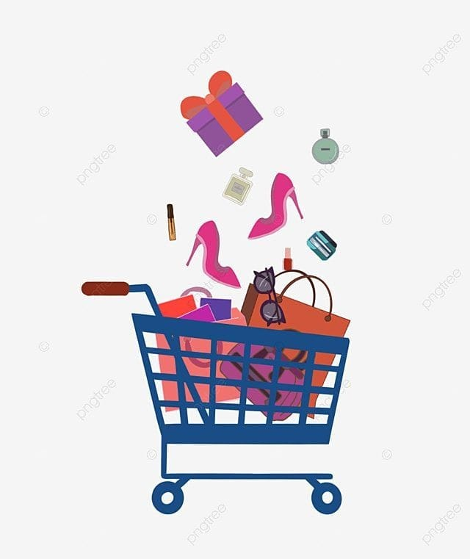
Problem Statement
We are integrating two problem statements:
Trend-Centric Recommendations: Employ AI-driven recommendation systems that analyze current fashion trends, customer preferences, and purchase history to deliver tailored product suggestions, enhancing customer engagement and conversion rates in the fast fashion segment
Engagement on a shopping platform - Building engagement constructs on a platform which will drive a connect and virality among younger audiences in the country. It need not be linked to shopping but needs to be linked to fashion, which will drive users to keep visiting the app on a habitual basis

Slide 3
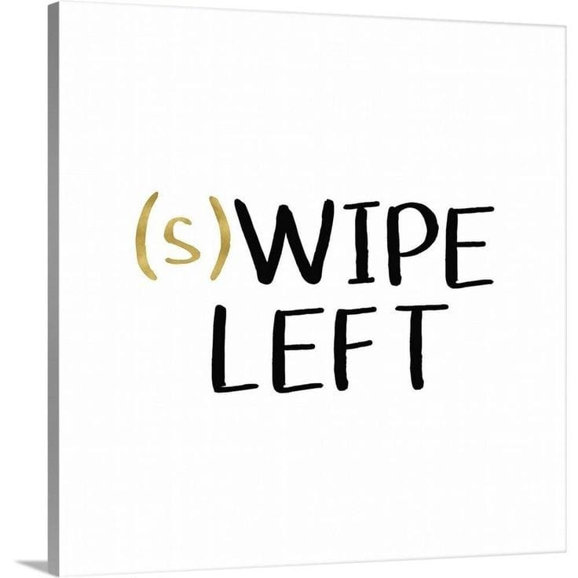

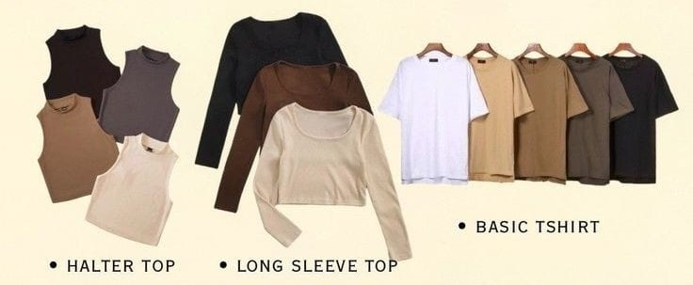
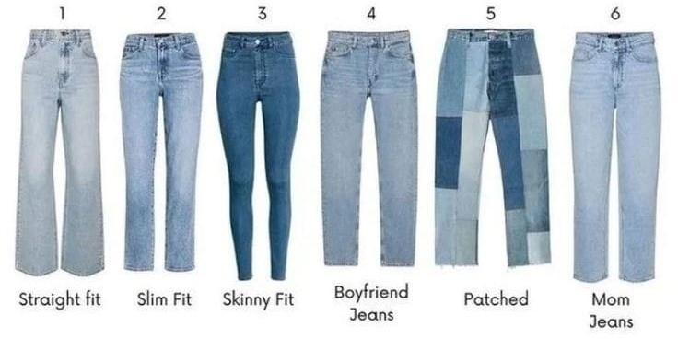
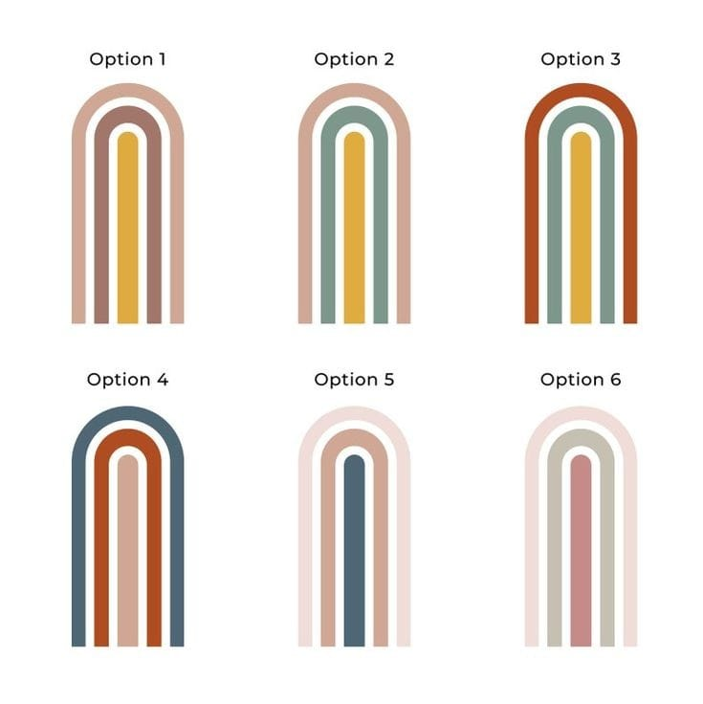
Solution
Creating a "swipe right" feature for a shopping platform is an innovative way to engage customers and provide a personalized shopping experience, similar to popular dating apps like Tinder.
"Your Dream Wardrobe is Just a Swipe Away!"
Swipe Right for Like: Customers swipe right to express interest in a product.
Swipe Left for Pass: Customers swipe left to skip a product.
Up/Down for More Info: Swipe up or down for additional product details, reviews, and similar items.
Wishlist Integration: Products swiped right are added to a wishlist or cart.
Recommendations Update: The algorithm refines product recommendations based on user swipes. You can also search on based on what you already have.
Implementing a "color block" feature in a shopping app can enhance the user experience by allowing customers to shop for clothing and accessories based on color combinations.
Color Block Filter: Add a filter option on the product listing page for users to select their preferred color blocks.
Color Palette: Display a palette of popular color combinations (e.g., black & white, red & blue).Visual Display: Show products in color blocks within the search results and product pages.

Slide 4
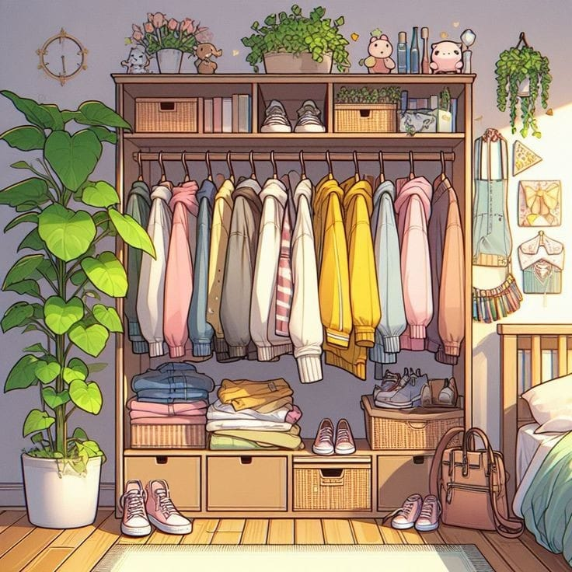

Integrating a sharing your customized outfit option within the Myntra in-app chatting feature can significantly enhance the shopping experience by allowing users to easily share product choices with friends, get opinions, and make collaborative shopping decisions.
Share Button: Add a share button on product pages, wishlists, and shopping carts that allows users to share items directly through Myntra’s in-app chat.
Chat Integration: Ensure the shared products appear as rich media messages within the chat, including product images, names, prices, and direct links.
Customer reward point system
Adding a daily check-in reward feature to the Myntra app can provide several benefits, particularly in terms of user engagement and retention.
Here are a few key points highlighting the advantages:
Daily Interaction, Habit Formation, Loyalty Building, Increased Browsing, decrease the likelihood of users abandoning the app.

Slide 5

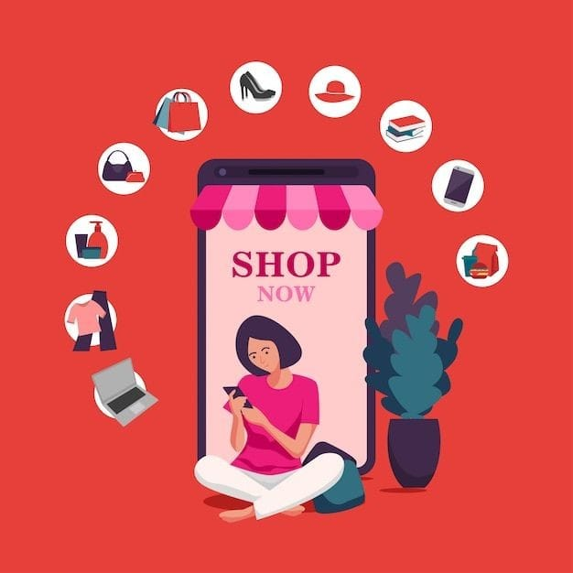
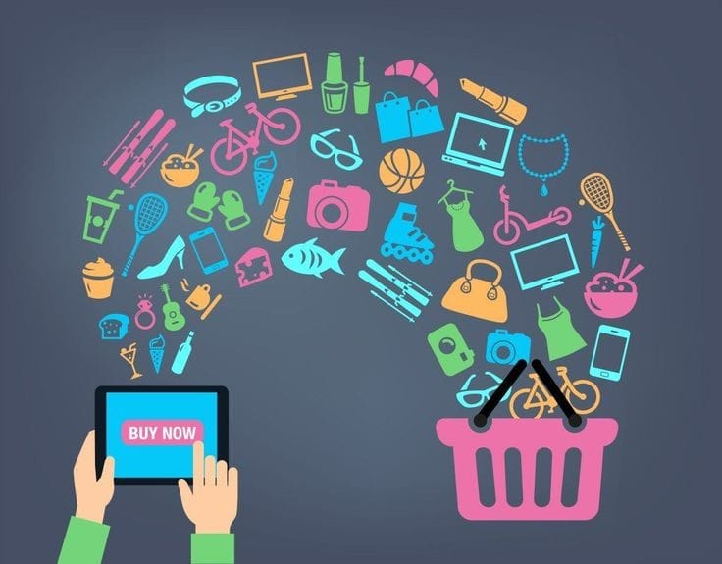
Benefits
Gamification: Adds an element of fun and gamification to the app, making it more enjoyable to use.
Stand Out in the Market: A unique feature like daily check-in rewards can differentiate the app from competitors. Attract New Users: Potential new users may be attracted by the prospect of earning rewards.
Reduced Friction: Simplifying the process of adding items to the cart encourages users to engage more with the app.
Users sharing products act as free advertising, leveraging word-of-mouth to reach a wider audience without additional marketing costs.
Increased Engagement: The interactive nature of swiping can lead to longer sessions and more frequent usage of the app
Encourages users to discover new products they might not have actively searched for, increasing exposure to a broader range of inventory.

